Slide 1
Data Structures and Algorithms
Lecture 1: Introduction

Slide 2
Structure of the Course
Lectures / Lab
Handson (Programming) in Lab
Test(s)
Midterm examination
Final examination

Slide 3
Grading
2 Test (N-1) 20%
Midterm Exam 20%
Project 20%
Final Exam 40%
Total 100%

Slide 4
Readings
Readings from the required text for each lecture -- read them in advance
The book contains self-test exercises in each section
Work these exercises (especially if you are new to the material)
Course books :
Data Structures and Algorithms in C++ Sartaj Sahni
Data Structures and Algorithm Analysis in C++ by Mark Allen Weiss
But I will use material from other books and research papers, so the ultimate source should be my lectures.

Slide 5
Syllabus
Logic Building, Flowcharting and Pseudo code development
Introduction to Abstract Data Types, basic terminology Data structure operations, algorithms, space and time complexity Review of basic mathematical and programming background
Arrays: one D, 2D and 3D, Traversal, insertion and deletion
Representation in memory, Row Major Column Major and C++ representation Records and Structures
Linked Lists, Linked List Operations
Stacks and Queues
Priority Queues through Heaps

Slide 6
Syllabus
Binary Tree, Linked Representation of Binary Trees, Insertion and Deletion, Traversal of Binary Trees (In order, Post order and Pre Order) Post Fix and Infix notations
Binary Search Trees, Insertion and Deletion
Graphs, Graph representation, Graph traversal algorithms, Searching algorithms
Searching, Linear Search, Binary Search
Sorting Algorithms

Slide 7
What is it all about?
Solving problems
Get me from home to work
Balance my checkbook
Simulate a jet engine
Graduate from university
Using a computer to help solve problems
Designing programs (architecture, algorithms)
Writing programs
Verifying programs
Documenting programs
Notes:
An example of manual Problem solving is like building a house…1st sketch is made like designing programs phase in computer science…Then that structure is worked out, similar to writing programs and then after building it must be checked for confirmation like program testing and finally it is documented…

Slide 8
Data Structures and Algorithms
A famous quote: Program = Algorithm + Data Structure
Algorithm
Outline, the essence of a computational procedure, step-by-step instructions
Data structure
Organization of data needed to solve the problem
Program – an implementation of an algorithm in some programming language

Slide 9
Algorithm Specification
Introduction
An algorithm is a finite set of instructions that accomplishes a particular task.
Criteria
input: zero or more quantities that are externally supplied
output: at least one quantity is produced
definiteness: clear and unambiguous
finiteness: terminate after a finite number of steps
effectiveness: instruction is basic enough to be carried out
Notes:
As we drive… while driving your input is speed and output is miles you travel.. Roads should be clear and finiteness not endless..

Slide 10
Algorithm Specification
Representation
A natural language, like English or Chinese.
A graphic, like flowcharts.
A computer language, like C.

Slide 11
Algorithm Analysis
Foundations of Algorithm Analysis and Data Structures.
Analysis:
How to predict an algorithm’s performance
How well an algorithm scales up
How to compare different algorithms for a problem
Data Structures
How to efficiently store, access, manage data
Data structures effect algorithm’s performance
Notes:
Analysis means to compare different solutions for a single problem/task

Slide 12
Example Algorithms
Two algorithms for computing the Factorial
Which one is better?
int factorial (int n) {
if (n <= 1) return 1;
else return n * factorial(n-1);
}
int factorial (int n) {
if (n<=1) return 1;
else {
fact = 1;
for (k=2; k<=n; k++)
fact *= k;
return fact;
}
}
Notes:
There are different criteria's in order to evaluate the performance of any product. For example for a mobile phone some people want simple mobile, while others have their own measures.. For comparison of algorithms One simplest matrix is LOC.. A program with fewer number of lines is more efficient as it takes small amount of memory, fast, and easy to remove bugs…

Slide 13
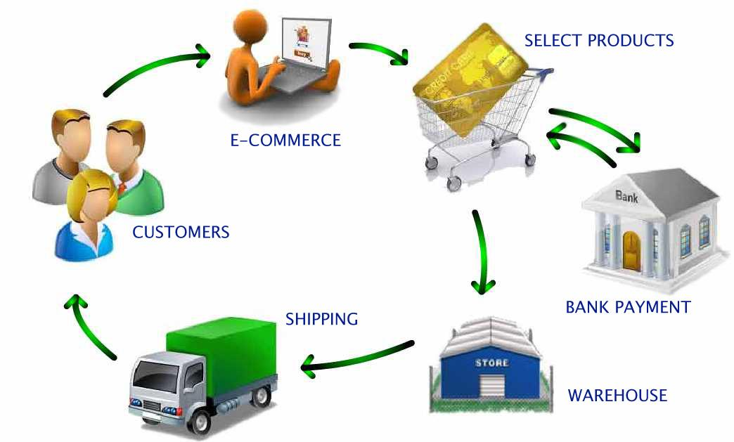

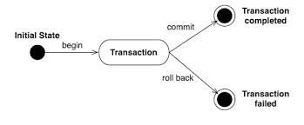
Role of Algorithms in Modern World
Enormous amount of data
E-commerce (Amazon, Ebay)
Network traffic (telecom billing, monitoring)
Database transactions (Sales, inventory)
Scientific measurements (astrophysics, geology)
Sensor networks. RFID tags
Bioinformatics (genome, protein bank)

Slide 14
Overall Picture
Data Structure and Algorithm Design Goals
Implementation Goals
Correctness
Robustness
Adaptability
Efficiency
Reusability

Slide 15
Overall Picture (2)
This course is not about:
Programming languages
Computer architecture
Software architecture
Software design and implementation principles
Issues concerning small and large scale programming
We will only touch upon the theory of complexity and computability

Slide 16
Algorithmic problem
Specification of output as a function of input
Specification of input
?
Infinite number of input instances satisfying the specification. For example:
A sorted, non-decreasing sequence of natural numbers. The sequence is of non-zero, finite length:
1, 20, 908, 909, 100000, 1000000000.

Slide 17
Algorithmic Solution
Input instance, adhering to the specification
Algorithm
Output related to the input as required
Algorithm describes actions on the input instance
Infinitely many correct algorithms for the same algorithmic problem

Slide 18
Example: Sorting
INPUT
sequence of numbers
OUTPUT
a permutation of the sequence of numbers
Sort
a₁, a₂, a₃,….,a_{n}
b₁,b₂,b₃,….,b_{n}
2 5 4 10 7
2 4 5 7 10
Correctness
For any given input the algorithm halts with the output:
b₁ < b₂ < b₃ < …. < b_{n}
b₁, b₂, b₃, …., b_{n} is a permutation of a₁, a₂, a₃,….,a_{n}
Running time
Depends on
number of elements (n)
how (partially) sorted they are
algorithm

Slide 19
Analysis of Algorithms
Efficiency:
Running time
Space used
Efficiency as a function of input size:
Number of data elements (numbers, points)
A number of bits in an input number

Slide 20
Analysis of Algorithms
What does it mean for an algorithm to be fast?
Low memory usage?
Small amount of time measured on a stopwatch?
Low power consumption?

Slide 21
How to Measure Algorithm Performance?
What metric should be used to judge algorithms?
Length of the program (lines of code)
Ease of programming (bugs, maintenance)
Memory required
Running time
Running time is the dominant standard.
Quantifiable and easy to compare
Often the critical bottleneck

Slide 22
Algorithm Strategies
Greedy
Divide and Conquer
Dynamic Programming
Exhaustive Search

Slide 23
Running Time
The running time of an algorithm varies with the input and typically grows with the input size.
Average case difficult to determine.
In most of computer science we focus on the worst case running time.
Easier to analyze.
Crucial to many applications: what would happen if an autopilot algorithm ran drastically slower for some unforeseen, untested inputs?

Slide 24
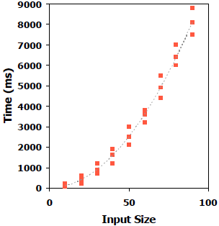
How to measure running time?
Experimentally
Write a program implementing the algorithm
Run the program with inputs of varying size
Measure the actual running times and plot the results
Why not?
You have to implement the algorithm which isn’t always doable!
Your inputs may not entirely test the algorithm.
The running time depends on the particular computer’s hardware and software speed.

Slide 25
Theoretical Analysis
Uses a high-level description of the algorithm instead of an implementation.
Takes into account all possible inputs.
Evaluate speed of an algorithm independent of the hardware or software environment.
By inspecting pseudocode, we can determine the number of statements executed by an algorithm as a function of the input size.

Slide 26
Elementary Operations
Algorithmic “time” is measured in elementary operations:
Math (+, -, *, /, max, min, log, sin, cos, abs, ...)
Comparisons ( ==, >, <=, ...)
Function calls and value returns
Variable assignment
Variable increment or decrement
Array allocation
Creating a new object (careful, object's constructor may have elementary ops too!)
In practice, all of these operations take different amounts of time.
For the purpose of algorithm analysis, we assume each of these operations takes the same time: “1 operation”

Slide 27
Example: Constant Running Time
function first(array):
// Input: an array
// Output: the first element
return array[O] // index O and return, 2 ops
How many operations are performed ¡n this function if the list has ten elements? If ¡t has 100,000 elements?
Always 2 operations performed
Does not depend on the input size

Slide 28
Example: Linear Running Time
function argmax(array):
// Input: an array
// Output: the index of the maximum value
index = O // assignment, 1 op
for i in [1, array.length): // 1 op per loop
if array[i] > array[index]: // 3 ops per loop
index = i // 1 op per loop, sometimes
return index // 1 op
How many operations if the list has ten elements? 100,000
elements?
Varies proportional to the size of the input list: 5n + 2.
We’ll be in the for loop longer and longer as the input list grows.
If we were to plot, the runtime would increase linearly.

Slide 29
Example: Quadratic Running Time
function possible_products(array):
// Input: an array
// Output: a list of all possible products
// between any two elements in the list
products = [] // make an empty list, 1 op
for i in [0, array.length): // 1 op per loop
for j in [0, array.length): // 1 op per loop
products.append(array[i] * array[j]) // 4 ops per per loop
return products // 1 op
Requires about 5n2 + n + 2 operations (okay to approximate!)
If we were to plot this, the number of operations executed grows quadratically!
Consider adding one element to the list: the added element must be multiplied with every other element in the list.
Notice that the linear algorithm on the previous slide had only one for loop, while this quadratic one has two for loops, nested. What would be the highest-degree term (in number of operations) if there were three nested loops?

Slide 30
Fibonacci: Recursive
0, 1, 1, 2, 3, 5, 8, 13, 21, 34, ...
The Fibonacci sequence is usually defined by the following recurrence relation:
F0=O,F1=1
F1 = F11 + F12
This lends itself very well to a recursive function for finding the nth Fibonacci number
function fib(n):
if n = 0:
return 0
if n = 1:
return 1
return fib(n-1) + fib(n-2)

Slide 31
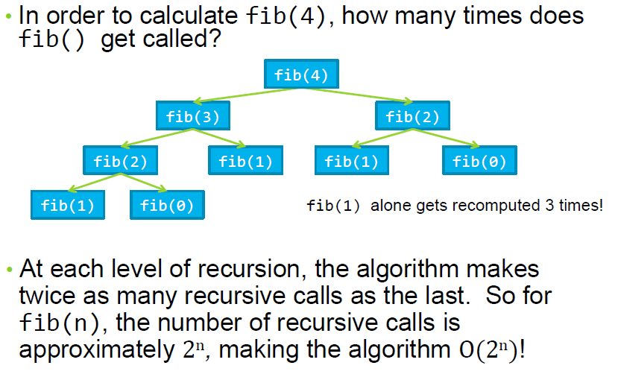
Fibonacci: Recursive

Slide 32
Fibonacci: Dynamic Programming
Instead of recomputing the same Fibonacci numbers over and over, we’ll compute each one only once and store it for future reference.
Like most dynamic programming algorithms, we’ll need a table of some sort to keep track of intermediary values.
function dynamicFib(n) :
fibs = [] // make an array of size n
fibs[O] = O
fibs[1] = 1
for i from 2 to n:
fibs[i] = fibs[i-1] + fibs[i-2]
return fibs[n]

Slide 33
Fibonacci: Dynamic Programming
What’s the runtime of dynamicFib()?
Since it only performs a constant number of operations to calculate each fibonacci number from 0 to n, the runtime is clearly O(n).
We have reduced the runtime of an algorithm from exponential to linear using dynamic programming!

Slide 34
Best/Worst/Average Case
Best case: elements already sorted → t_{j}=1, running time = f(n), i.e., linear time.
Worst case: elements are sorted in inverse order → t_{j}=j, running time = f(n²), i.e., quadratic time
Average case: t_{j}=j/2, running time = f(n²), i.e., quadratic time

Slide 35
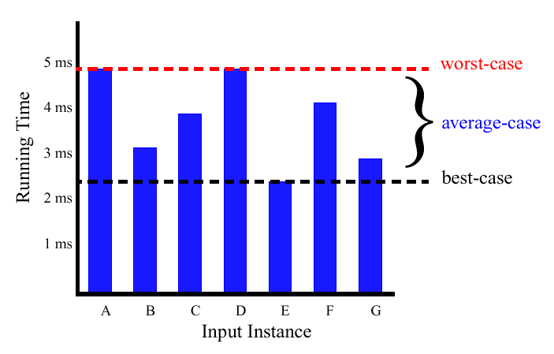
Best/Worst/Average Case (2)
For a specific size of input n, investigate running times for different input instances:
6n
5n
4n
3n
2n
1n

Slide 36
Best/Worst/Average Case (3)
For inputs of all sizes:
worst-case
6n
average-case
5n
best-case
Running time
4n
3n
2n
1n
1 2 3 4 5 6 7 8 9 10 11 12 …..
Input instance size

Slide 37
Best/Worst/Average Case (4)
Worst case is usually used:
It is an upper-bound and in certain application domains (e.g., air traffic control, surgery) knowing the worst-case time complexity is of crucial importance
For some algorithms worst case occurs fairly often
The average case is often as bad as the worst case
Finding the average case can be very difficult

Slide 38
Introduction to Data Structures
Data
Data are values or a set of values
Data item refers to single unit of values
Data item
Group item :
Data item that can be subdivided into sub item.
Ex Name : First Name, Middle initial and Last Name
Elementary item:
Data item that can not be sub divided into sub item
Ex : PAN card number / Bank Pass Book Number is treated as single item
Collection of data are frequently organized into a hierarchy of fields, records and files

Slide 39
Data Structures
Field
is a single elementary unit of information representing an attribute of an entity
Record
is the collection of field values of a given entity
File
is the collection of records of the entities in a given entity set
Name | Age | Sex | Roll Number | Branch
A | 17 | M | 109cs0132 | CSE
B | 18 | M | 109ee1234 | EE
C | 19 | F | 109ce0012 | CE
D | 20 | F | 108mm0132 | MM

Slide 40
Data Structures
Entity
Something that has certain attributes or properties which may be assigned values
Values may be numeric or non-numeric
Ex The employee of an organization
Attributes Name Age Sex Employee Code
Values John 33 M 3472

Slide 41
Data Structures
Entity Set
Entity with similar attributes ( e. g all employees of an organization) form an entity set
Each attribute of an entity set has a range of values [ the set of possible values that could be assigned to the particular attribute]
Information: Data with given attribute or processed data

Slide 42
Introduction to Data Structures
Record
Record may be of fix and variable length
Fixed Length Record
All records contain the same amount of data items with the same amount of space assigned to each data item
Variable Length Record
File records may contain different lengths.
e.g student record usually have variable lengths .since different students take different number of courses
Usually variable length records have a minimum and a maximum length

Slide 43
Introduction to Data Structures
Data is a set of elementary items.
How do we organize information so that we can find, update, add and delete portions of it efficiently?
“The data structures deal with the study of how the data is organized in the memory, how efficiently it can be retrieved and manipulated and the possible ways in which different data items are logically related”.

Slide 44
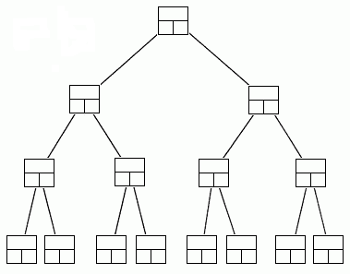
Data Structures
A data structure is a scheme for organizing data in the memory of a computer.
Some of the more commonly used data structures include lists, arrays, stacks, queues, heaps, trees, and graphs.
Binary Tree

Slide 45
Data Structures
It’s an agreement about:
how to store a collection of objects in memory
What operations we can perform on that data
The algorithms for those operations
How time and space efficient those algorithms are.

Slide 46
Data Structures
The way in which the data is organized affects the performance of a program for different tasks.
Computer programmers decide which data structures to use based on the nature of the data and the processes that need to be performed on that data.
They can be classified in to
Primitive data structures
Non primitive data structure.

Slide 47
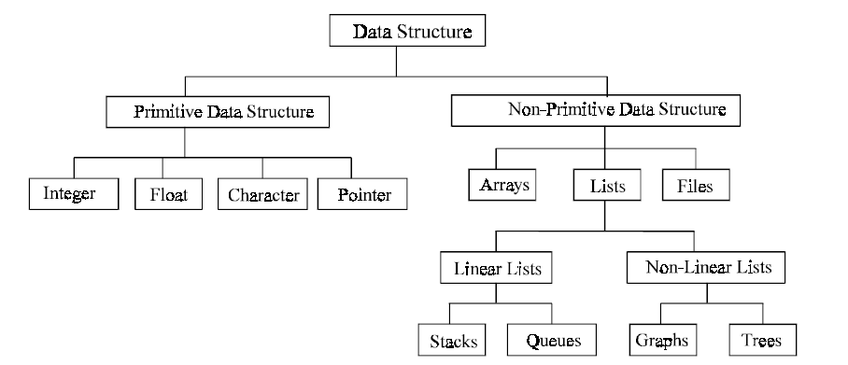
Classifications of Data Structures

Slide 48
Classifications of Data Structures
Primitive data structure
Basic data types that are available in most of the programming languages. The primitive data types are used to represent single values.
These are data structures that can be manipulated directly by machine instructions.
Primitive types are also known as built-in types or basic types.
In C language, the different primitive data structures are int, float, char, double.
Non primitive data structures
The data types that are derived from primary data types are known as non-Primitive data types. These data types are used to store group of values.
These are data structures that can not be manipulated directly by machine instructions. Arrays, linked lists, files etc., are some of non-primitive data structures and are classified into linear data structures and non-linear data structures.

Slide 49
Linear and non- linear data structures
The data structures that show the relationship of logical adjacency between the elements are called linear data structures.
Otherwise, they are called non-linear data structures.
Different linear data structures are stacks, queues, linear linked lists such as singly linked list, doubly linked linear lists etc.
Trees, graphs and files are non-linear data structures.

Slide 50
Common Data Structures
Array
Stack
Queue
Linked List
Tree
Heap
Hash Table
Priority Queue

Slide 51
Functions of Data Structures
Add
Index
Key
Position
Priority
Get
Change
Delete

Slide 52
Data Structure Example Applications
1. How does Google quickly find web pages that contain a search term?
2. What’s the fastest way to broadcast a message to a network of computers?
3. How can a subsequence of DNA be quickly found within the genome?
4. How does your operating system track which memory (disk or RAM) is free?
5. In the game Half-Life, how can the computer determine which parts of the scene are visible?

Slide 53
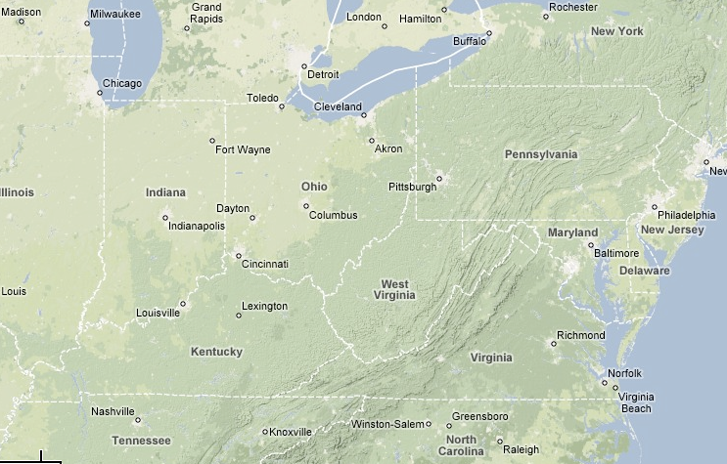
Suppose You’re Google Maps...
You want to store data about cities (location, elevation, population)...
What kind of operations should your data structure(s) support?

Slide 54
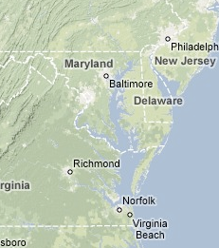
Operations to support the following scenarios...
Finding addresses on map?
Lookup city by name...
Mobile iPhone user?
Find nearest point to me...
Car GPS system?
Calculate shortest-path between cities...
Show cities within a given window...
Political revolution?
Insert, delete, rename cities

Slide 55
Data Organizing Principles
Ordering
Put keys into some order so that we know something about where each key is, relative to the other keys.
Phone books are easier to search because they are alphabetized.
Linking
Add pointers to each record so that we can find related records quickly.
E.g. The index in the back of book provides links from words to the pages on which they appear.
Partitioning
Divide the records into 2 or more groups, each group sharing a particular property.
E.g. Multi-volume encyclopedias (Aa-Be, W-Z)
E.g. Folders on your hard drive

Slide 56
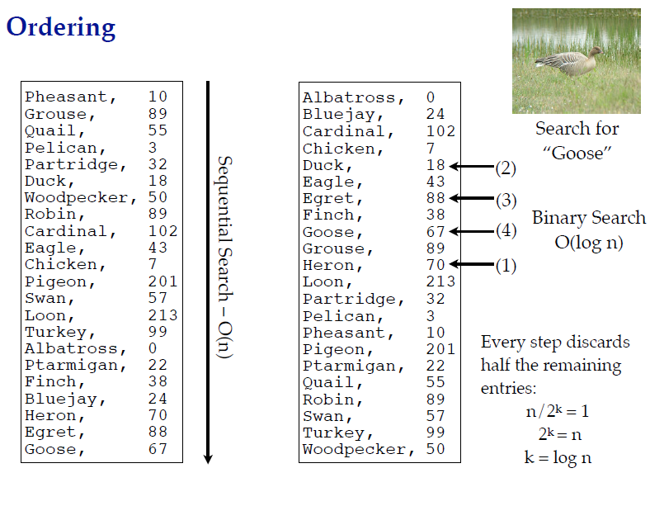

Slide 57
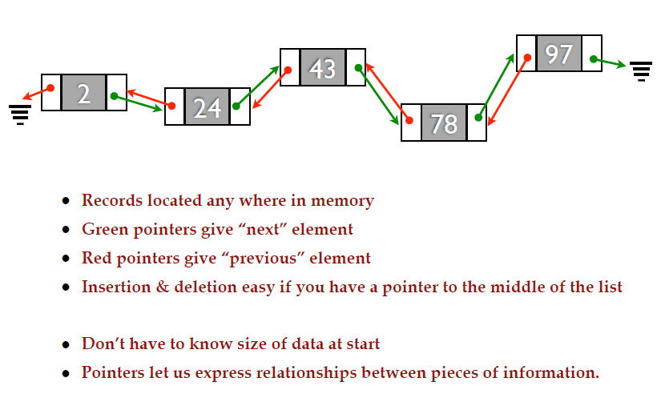
Linking

Slide 58
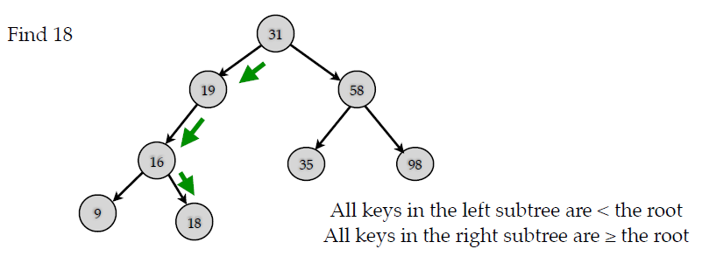
Partitioning
Ordering implicitly gives a partitioning based on the “<“ relation.
Partitioning usually combined with linking to point to the two halves.
Prototypical example is the Binary Search Tree:

Slide 59
Data abstraction
Data Type A data type is a collection of objects and a set of operations that act on those objects.
For example, the data type int consists of the objects {0, +1, -1, +2, -2, …, INT_MAX, INT_MIN} and the operations +, -, *, /, and %.
The data types of C
The basic data types: char, int, float and double
The group data types: array and struct
The pointer data type
The user-defined types

Slide 60
Data abstraction
Abstraction? Anything that hides details & provides only the essentials.
Abstract Data Type
An abstract data type(ADT) is a data type that is organized in such a way that the specification of the objects and the operations on the objects is separated from the representation of the objects and the implementation of the operations.
We know what is does, but not necessarily how it will do it.

Slide 61
Abstract Data Type
A mathematical model of the data objects that make up a data type as well as the functions that operate on these objects.
An abstract data type (ADT) specifies behavior, but not implementation
An implementation uses a particular low-level data type to implement the desired behavior.

Slide 62
ADTs
While designing ADTs, a designer has to deal with two types of questions:
(i) What values are in the domain? What operations can be performed on the values of a particular data type?
(ii) How is the data type represented? How are the operations implemented?

Slide 63
ADTs
ADTs specification answers the ‘what’ questions. Specification is written first.
ADTs implementation answers the ‘how’ questions. Done after specification.
Users & Implementers.
Users of an ADT need only know the specification …. no implementation details.← advantage
Programmer (Implementer) who implements ADT is concerned with specification, representation and implementation.

Slide 64
ADTs
Elements
Structure
Domain
Operations
User of an ADT
must know
only this
Specification
Implementer must
know all these.
Representation
Implementation

Slide 65
Example
A stack is an abstract data type (ADT).
We push and pop from the top.
Consider three implementations:
(1) Every push causes all elements in an array to shift
down 1 before the insertion at s[0].
(2) We add at stackTop and then add one to stackTop.
(3) A linked list use where the top is always at the list’s
front end.
Each implementation can be written correctly.
Implementation (1) runs in Θ(n).
Implementations (2) and (3) run in Θ(1).

Slide 66
Big O Notation
Big O notation is used in Computer Science to describe the performance or complexity of an algorithm.
It is the formal method of expressing the upper bound of an algorithm's running time. It's a measure of the longest amount of time it could possibly take for the algorithm to complete.
Big O specifically describes the worst-case scenario, and can be used to describe the execution time required or the space used (e.g. in memory or on disk) by an algorithm.

Slide 67
O(1)
O(1) describes an algorithm that will always execute in the same time (or space) regardless of the size of the input data set.
O(N)
O(N) describes an algorithm whose performance will grow linearly and in direct proportion to the size of the input data set.

Slide 68
O(N²)
O(N²) represents an algorithm whose performance is directly proportional to the square of the size of the input data set.
This is common with algorithms that involve nested iterations over the data set. Deeper nested iterations will result in O(N³), O(N⁴) etc.

Slide 69
O(2^{N})
O(2^{N}) denotes an algorithm whose growth will double with each additional element in the input data set. The execution time of an O(2^{N}) function will quickly become very large.

Slide 70
Logarithms O(log N)
The iterative halving of data sets described in the binary search example produces a growth curve that peaks at the beginning and slowly flattens out as the size of the data sets increase.
Notes:
e.g. an input data set containing 10 items takes one second to complete, a data set containing 100 items takes two seconds, and a data set containing 1000 items will take three seconds. Doubling the size of the input data set has little effect on its growth as after a single iteration of the algorithm the data set will be halved and therefore on a par with an input data set half the size. This makes algorithms like binary search extremely efficient when dealing with large data sets.

Slide 71
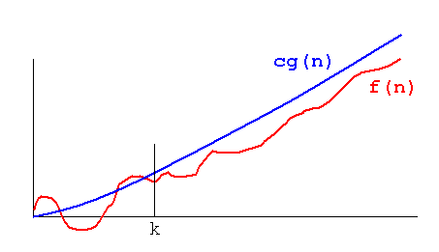
Let f(n) and g(n) be two functions on positive integers. We say f(n) is O(g(n)) if there exist two positive constants c and k such that f(n) <= cg(n) for all n >= k.

Slide 72
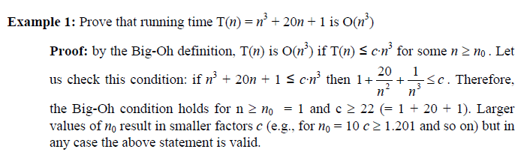
Proving Big-Oh: Example 1
Notes:
e.g. an input data set containing 10 items takes one second to complete, a data set containing 100 items takes two seconds, and a data set containing 1000 items will take three seconds. Doubling the size of the input data set has little effect on its growth as after a single iteration of the algorithm the data set will be halved and therefore on a par with an input data set half the size. This makes algorithms like binary search extremely efficient when dealing with large data sets.

Slide 73
Examples:
f(n) = 10n + 5 and g(n) = n f(n) is O(g(n))
To show f(n) is O(g(n)) we must show constants c and k such that f(n) <= cg(n) for all n >=k
or: 10n+5 <= cn for all n >= k
Try c = 15. Then we need to show: 10n + 5 <= 15n.
Solving for n we get: 5 <= 5n or 1 <= n.
So f(n) = 10+5 <= 15g(n) for all n >= 1. (c = 15, k = 1).
Therefore we have shown f(n) is O(g(n)).
Notes:
We are allowed to choose c and k to be integers we want as long as they are positive. They can be as big as we want, but they can't be functions of n.

Slide 74
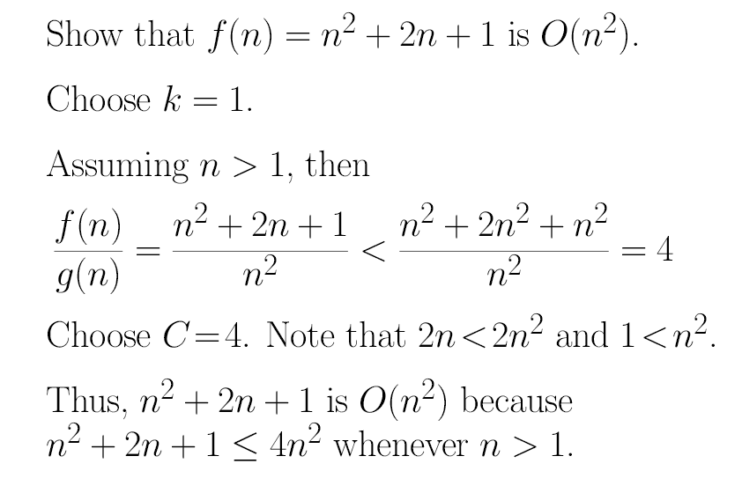
Proving Big-Oh: Example 2
Notes:
forget about lower-order terms
• forget about constant factors

Slide 75
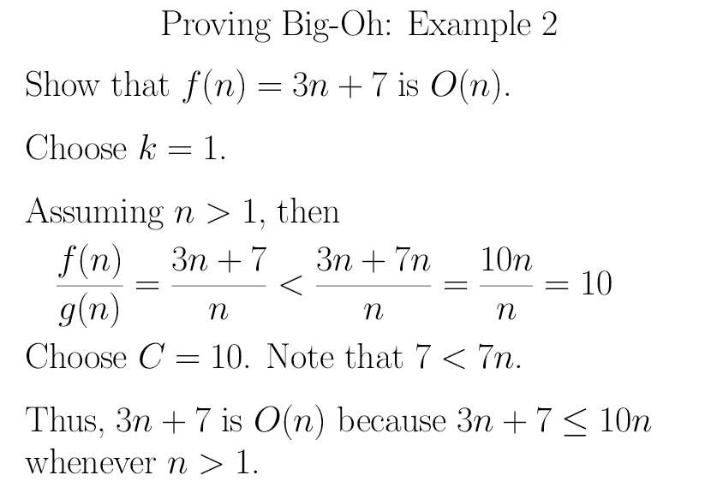
Proving Big-Oh: Example 3
Notes:
e.g. an input data set containing 10 items takes one second to complete, a data set containing 100 items takes two seconds, and a data set containing 1000 items will take three seconds. Doubling the size of the input data set has little effect on its growth as after a single iteration of the algorithm the data set will be halved and therefore on a par with an input data set half the size. This makes algorithms like binary search extremely efficient when dealing with large data sets.

Slide 76
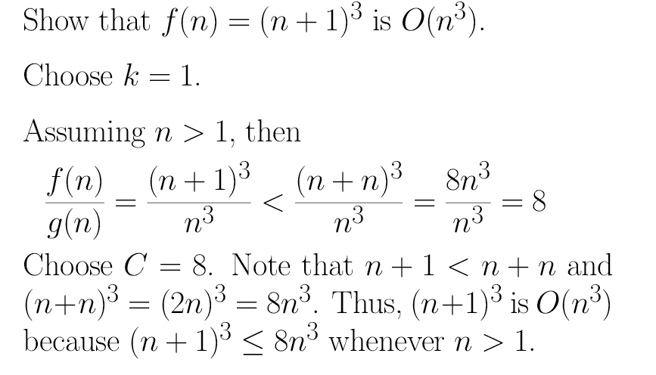
Proving Big-Oh: Example 4
Notes:
e.g. an input data set containing 10 items takes one second to complete, a data set containing 100 items takes two seconds, and a data set containing 1000 items will take three seconds. Doubling the size of the input data set has little effect on its growth as after a single iteration of the algorithm the data set will be halved and therefore on a par with an input data set half the size. This makes algorithms like binary search extremely efficient when dealing with large data sets.

Slide 77
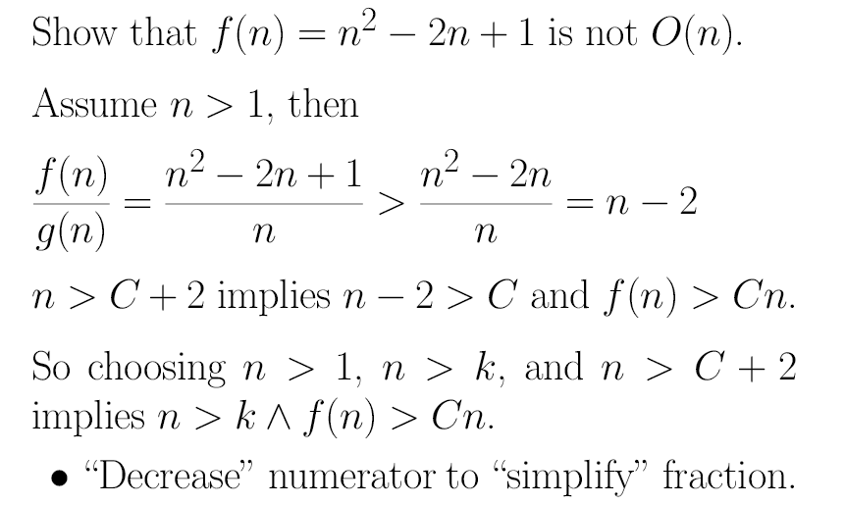
Proving Not Big-Oh: Example 1
Notes:
e.g. an input data set containing 10 items takes one second to complete, a data set containing 100 items takes two seconds, and a data set containing 1000 items will take three seconds. Doubling the size of the input data set has little effect on its growth as after a single iteration of the algorithm the data set will be halved and therefore on a par with an input data set half the size. This makes algorithms like binary search extremely efficient when dealing with large data sets.

Slide 78
Sources used
Lectures by Mr. Mohammad Asad Abbasi

